Slide 1
Sequence diagrams
Sequence diagram: an “interaction diagram” that models a single scenario executing in a system
Shows what messages are sent and when
Visualizes the execution sequences of an use case

Slide 2
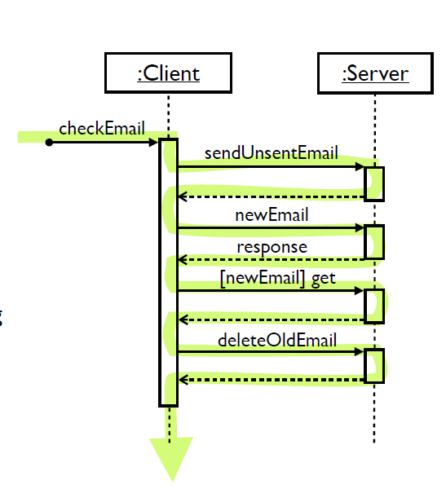
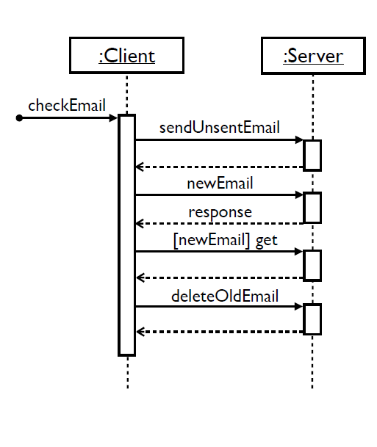
Key parts of a sequence diagram
Participant: an object or an entity; the sequence diagram actor
sequence diagram starts with an unattached "found message" arrow
Message: communication between objects
Axes in a sequence diagram:
horizontal: which participant is acting
vertical: time (↓ forward in time)

Slide 3
Sequence diagram from a use case
The user presses the “check email” button.
The client first sends all unsent email to the server.
After receiving an acknowledgement, the client asks the server if there is any new email.
If so, it downloads the new email.
Next, it deletes old thrashed email from the server.
:Client
:Server
checkEmail
sendUnsentEmail
newEmail
response
[newEmail] getEmail
deleteOldEmail

Slide 4
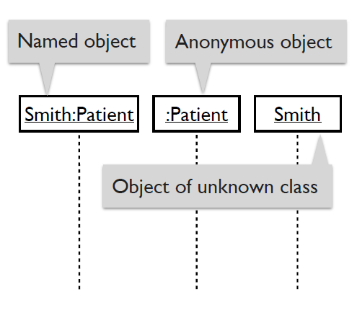
Syntax: Representing objects
Objectname:classname
An object: a box with an underlined label that specifies the object type, and optionally the object name.
Write the object's name if it clarifies the diagram.
An object's "life line" is represented by a dashed vertical line.
Represents the life span of the object during the scenario being modeled

Slide 5
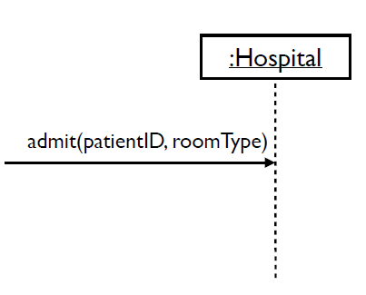
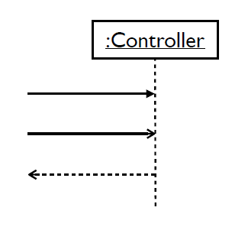
Representing messages between objects
A message (method call): horizontal arrow to the receiving object.
Write message name and arguments above the arrow.
Type of arrow indicates types of messages:
Synchronous message: solid arrow with a solid head.
Asynchronous message: solid arrow with a stick head.
Return message: dashed arrow with stick head.

Slide 6
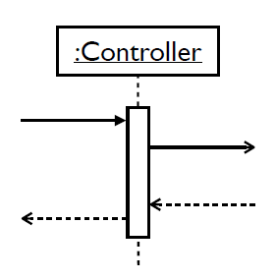
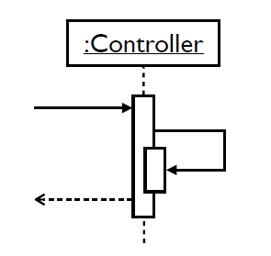
Indicating method execution
Activation: thick box over object's life line, drawn when an object's method is on the stack
Either that object is running its code, or it is on the stack waiting for another object's method to finish
Nest activations to indicate an object calling itself.

Slide 7
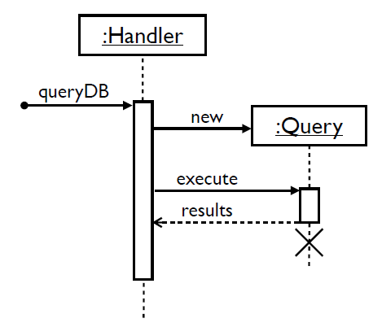
Lifetime of objects
Object creation: an arrow with new written above it
An object created after the start of the scenario appears lower than the others.
Object deletion: X at the bottom of object's lifeline
Java doesn't explicitly delete objects; they fall out of scope and are garbage collected.

Slide 8
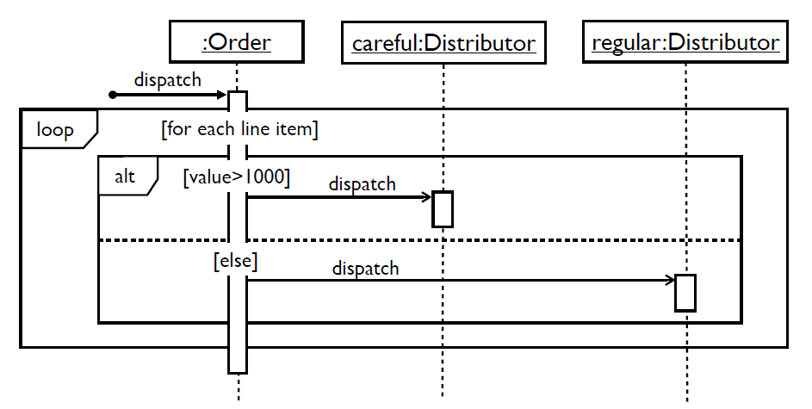
Alternatives, options, and loops
Frame: a box around part of a sequence diagram
if → (opt) [condition]
if/else→ (alt) [condition], separated by horizontal dashed line
loop → (loop) [condition or items to loop over]

Slide 9
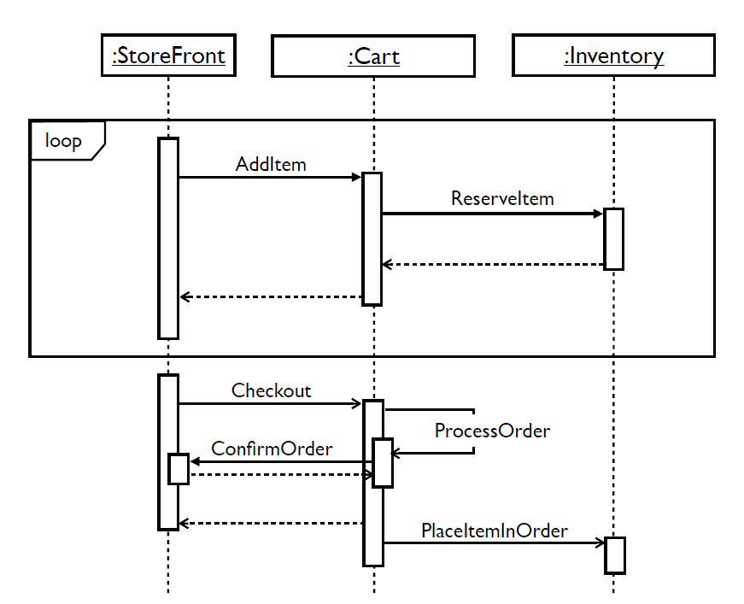
Example: Sequence diagram

Slide 10
Example
https://creately.com/blog/diagrams/sequence-diagram-tutorial/#:~:text=get%20something%20done.-,Sequence%20Diagram%20Notations,them%20are%20represented%20by%20arrows.

